Slide 1
Section 8.5
Simple Harmonic Motion;
Damped Motion;
Combining Waves

Slide 3
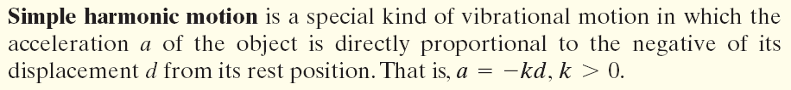
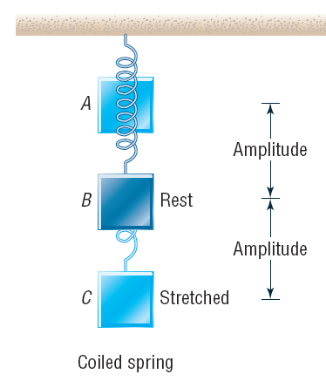
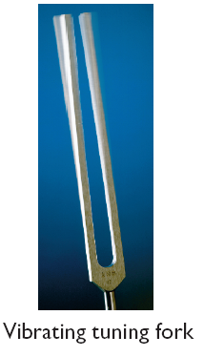

Slide 4
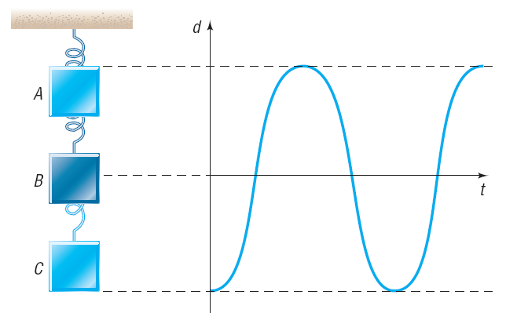

Slide 5

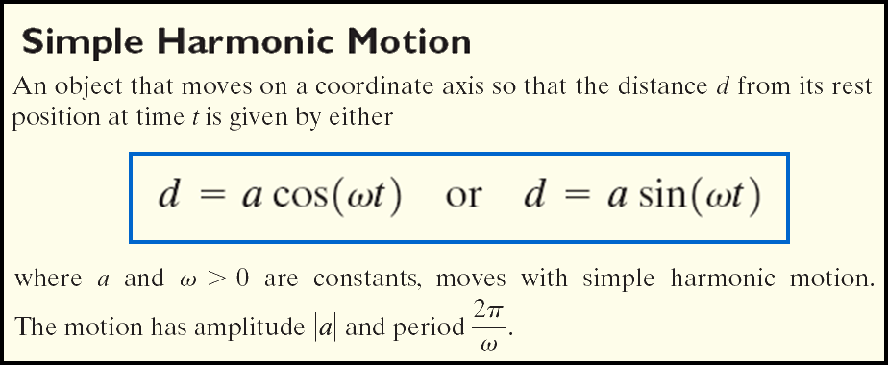

Frequency

Slide 6

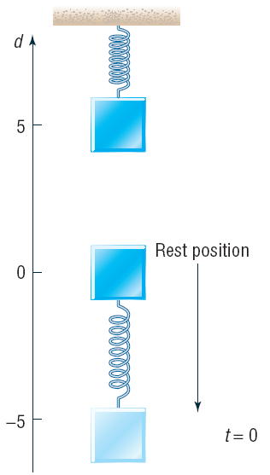


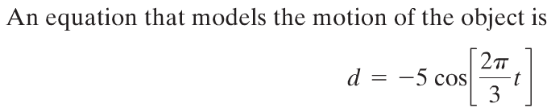
Suppose that an object attached to a coiled spring is pulled down a distance of 5 inches from its rest position and then released. If the time for one oscillation is 3 seconds, write an equation that relates the displacement d of the object from its rest position after time t (in seconds). Assume no friction.

Slide 8
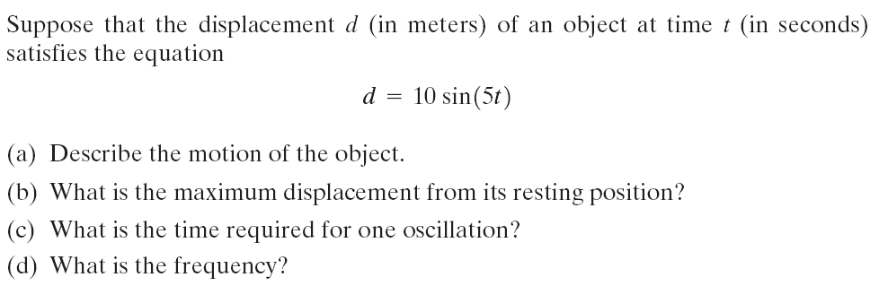
d = 25 cos (4t)

Slide 10

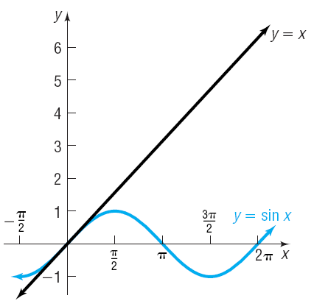

Slide 11
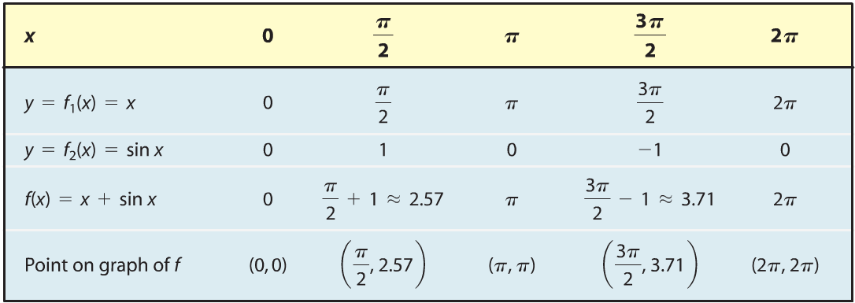
Select several values of x and compute f₁(x), f₂(x) and
f(x) = f₁(x) + f₂(x).

Slide 12
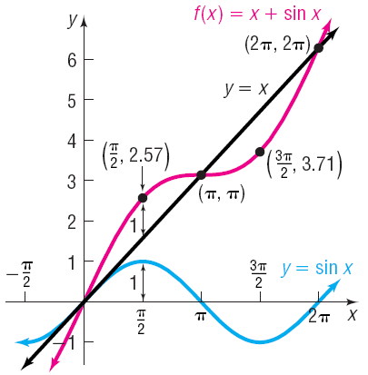

Slide 13

